Slide 1

Sprint-1
Ecommerce Case study
By: vikram patil

Slide 2
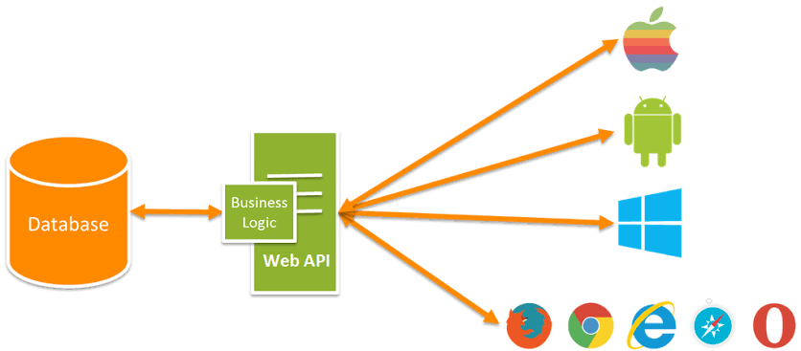
Flow chart

Slide 3
Tables in Database
Login Table:
Id | UserName | Password | IsAdmin
Product Table:
Id | ProductName | ProductDesc | CatId | ProductImage | ProductMrp | ProductDiscount | ProductFinal | ProductQuantity
Category Table:
Id | CategoryName

Slide 4
Features
1. Created a Ecommerce web API in DOT NET
2. Sql server management studio used as database.
3. Angular is use as front end or client .
4.For authentication I used JWT.JSON web tokens.
User Section: 1. User can register and login
2. User can see the products
3. User can add products to cart
Admin Section: 1. Admin can login
2. Admin can add products

Slide 5
Thank You

